Slide 1
Governing, standard setting and capacity building new age Islamic finance
Mughees Shaukat Senior Manager, Capacity Building, R&D and International Affairs
Houston, Taxes, United States 20 oct 2023

Slide 3
A.K.A Asserting the “Dignity Conscious” Islamic Finance in Times of New Normal

Slide 4
THE NEW NORMAL
The Post Covid World
The Tech/Digital Disrupted World
The Cyber and Cyber Security Prone World
The Climate Change Ridden World
The Renewable Energy World
The Shifting to another Planet World

Slide 5
FinTech A.K.A Risk Sharing Islamic Finance
What is crucially noteworthy is the fact that the fintech driven, new age, finance is in complete actuality, application of 101 Islamic Finance i.e. a simple resortion to Mudaraba and Musharaka financing via e.g. crowd Funding, Angel Investing ,P2P
In a typical risk sharing arrangement such as equity finance, parties share the risk as well as the rewards of a contract. Assets are invested in remunerative trade and production activities. The return to assets are not known at the instant assets are invested, akin to Arrow-Debreu securities.

Slide 6
CYBER RISKS: THE DARK SIDE OF TECHNOLOGY BLISS
“As we become more reliant on the bliss of technology, digital banking, services and
payments, there is a dark side that comes as an inevitable package deal: CYBER RISKS.
The number of cyberattacks has tripled over the last decade, and financial services is the most targeted industry.
Cybersecurity has clearly become a threat to financial stability. Given strong financial and technological interconnections, a successful attack on a major financial institution, or on a core system or service used by many, could quickly spread through the entire financial system causing widespread disruption and loss of confidence”.
Transactions could fail as liquidity is trapped, household and companies could lose access to deposits and payments. Under extreme scenarios, investors and depositors may demand their funds or try to cancel their accounts or other services and products they regularly use. A NEW KIND OF BANK RUNS.

Slide 7
“Its the Climate Change Stupid”
LIGHTING TO STRIKE TWICE WITH AN EVEN BIGGER PERHAPS PERPETUAL THUNDER BOLTS
T

Slide 8
Organizing Principles of Islamic Finance Hence the Dignity and the Value Preposition
Al-Quran: Verse 275 of Chapter 2
Bay’ (exchange): Necessary Condition.
No Riba: Sufficient Condition.
Present architecture of Islamic Finance
. No Riba, but…..
The Malaysian and Oman Paradigm

Slide 9
Standardisation secures integrity of Islamic finance
2.
industry not compromising on the minimum level of Shari’ah-compliance in all areas of operations;
3.
industry adopting the best practices;
4.
industry enjoying the trust and confidence of its stakeholders; and
5.
industry is stable, sustainable, and competitive.
Standardisation is important to secure the integrity of Islamic finance where integrity is characterized by the following:
1.
industry moving in one direction towards realization of Maqasid Al Shari’ah;

Slide 10
Standardisation benefits all Islamic finance stakeholders
Standardization and harmonization of best practices in Islamic finance
leads to
Islamic finance stakeholders
Higher levels of trust because of higher:
Benefits to economy
Benefits to regulator
Benefits to investor
Benefits to IFIs
attracts foreign investment
No need to reinvent the wheel and develop the standards from scratch
better forecasting
better governance
interoperability of products
comparability
better resource allocation
better decision-making
lower cost of capital
better HR availability
transparency
Secure adequate capacity in the market
reduced costs
uniformity of processes
increased wealth
reliability
improved intl. reputation
Increased focus on supervision
higher productivity
appropriate risk management
understandability
attracts foreign talent
Internal capacity shortage does not become a challenge
higher legal security
accountability
attracts foreign technology
higher adaptability
timeliness

Slide 11
About capacity building programs of AAOIFI
02

Slide 12
Our driving beliefs for capacity building programs
The standards issued by the infrastructural institutions, such as AAOIFI’s and others, must serve as the fundamentals of Islamic finance simply because it represents consensus of the leading minds of the industry
Knowledge should only be transmitted by highly qualified, experienced, and committed professionals who have a proven track record in Islamic finance
The subject of ethics should become an everyday topic of learning and practice for all stakeholders, at all levels, and on ongoing continuing basis

Slide 13
Bird’s eye view of the AAOIFI’s capacity building ecosystem (June 2023)
Professional programs
Network
Career
Recognition
AAOIFI’s capacity building ecosystem
Governance structure
AAOIFI Education Board (AEB)
Curriculum Review Committee (CRC)
Examinations Review Committee (ERC)
Translation Review Committee (TRC)
Fellowships
Certificates of Proficiencies
Workshops
AAOIFI Q&A Forum
AAOIFI Global Fellows Forum (GFF)
AAOIFI Capacity Building Conference
AAOIFI Job Portal
Membership of AEB and its subcommittees
Name published on AAOIFI’s website
Fellows’ webinars
AAOIFI Recognised Trainer
Infrastructure setup
Candidate Registration Centres
Examination Centres
Training Partners
Professional platforms
AAOIFI Affiliate University
Certified Islamic Professional Accountant (CIPA)
Certified Shari’ah Expert (CSE)
Certified Shari’ah Auditor (CSA)
…in Financial Accounting Standards (CPFAS)
Directors Sensitisation Program
CFO Update Program
Professional Ethics Program (PEP)

Slide 14
Professional programs of AAOIFI

Slide 15
AAOIFI offers 3 professional fellowship programs in 3 languages
Professional Fellowship Programs of AAOIFI
Certified Islamic Professional Accountant (CIPA)
English
Arabic
Russian
Certified Shari’ah Expert (CSE)
Arabic
Certified Shari’ah Auditor (CSA)
Arabic
Certified Shari’ah Advisor and Auditor
To be discontinued after September 2023

Slide 16
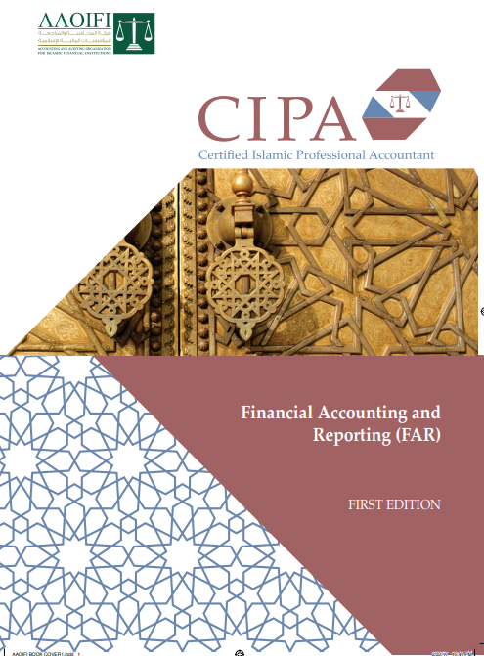
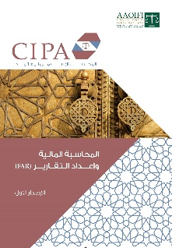
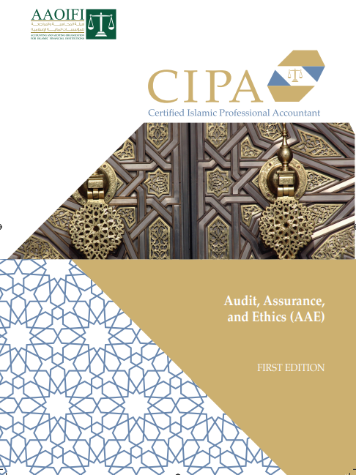
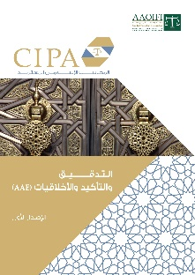
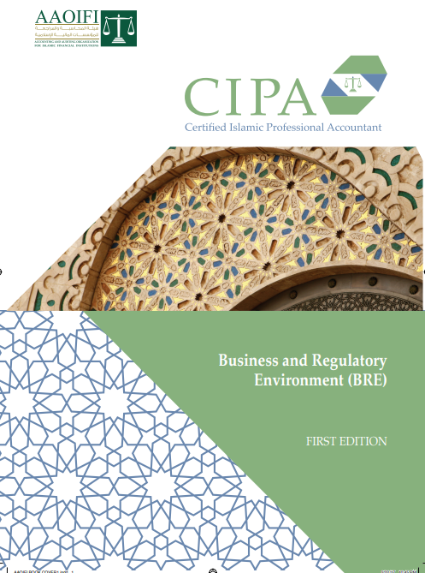
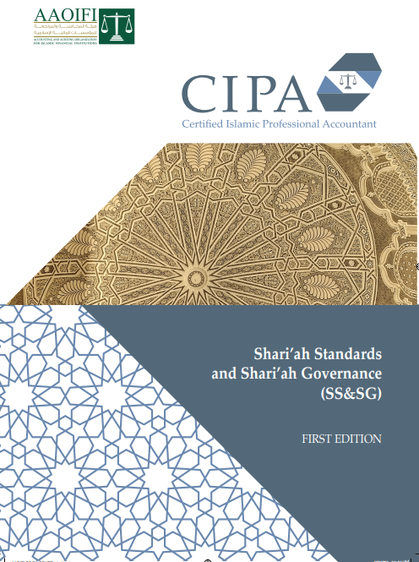
Certified Islamic Professional Accountant (CIPA)
English
Arabic
Russian
Financial Accounting Standards (FAR)
Launched in 2006
Revamped and relaunched in 2017
4 Modules and 1-year practical experience requirement (PER)
Offered in English, Arabic and Russian languages
Audit Assurance and Ethics (AAE)
Business and Regulatory Environment (BRE)
Shari’ah Standards and Shari’ah Governance (SSSG)

Slide 17
Certified Shari’ah Expert (CSE)
Launched in 2023
4 Modules and 1-year practical experience requirement (PER)
Offered in Arabic language only; will be translated to English language
Islamic Financial Structuring and Development (IFSD) الهيكلة المالية الإسلامية
AAOIFI Technical Standards (ATS) معايير أيوفي الفنية
Shari’ah Standards (SS) المعايير الشرعية
Business and Regulatory Environment (BRE) البيئة التجارية والرقابية

Slide 18
Certified Shari’ah Advisor (CSA)
Launched in 2023
4 Modules and 1-year practical experience requirement (PER)
Offered in Arabic language only; will be translated to English language
Shari’ah Standards (SS) المعايير الشرعية
Shari’ah Audit, Governance and Ethics (SAGE) التدقيق الشرعي والحوكمة
Financial Accounting and Auditing (FAA) مقدمة للمحاسبة المالية والتدقيق
Business and Regulatory Environment (BRE) البيئة التجارية والرقابية

Slide 19
Certificate of Proficiency in Financial Accounting Standards (CPFAS)
Launched in 2022
1 module exam
Offered in English language only
28 FASs covered
250 hours of self study required, at minimum

Slide 20
Why should you pursue AAOIFI fellowships and certificates of proficiencies?
Why should you pursue AAOIFI fellowships and become an AAOIFI fellow?
Superior learning content
Globally recognized premier institution
Enhanced career prospects

Slide 21
Steps to becoming an AAOIFI fellow
Register for the fellowship
Pass the exams
Complete Practical Experience Requirement (PER)
Complete Annual CPD hours
Pay Annual Fellowship fee

Slide 22
Professional workshops
10-day workshop on Summary of AAOIFI standards
To summarize the key requirements of the most important standards, including its implementation implications, in each area of standard-setting (Shari’ah, accounting, auditing, governance, and ethics)
Directors Sensitization Program
To help the directors and senior management of Islamic Financial Institutions (IFIs) understand diverse topic areas: AAOIFI, IFSB, IIFM standards, takaful, risk management, capital adequacy, profit and loss distribution, and sukuk, respectively
Professional Ethics Program (PEP)
To train the employees in understanding the demands of ethical conduct and choosing the right course of action in an ethical dilemma or difficulty.
10-day CIPA/CSAA Crash Course program
To cover the given curriculum of CIPA and CSAA programs in the most effective manner (by discussing only key points) and in the shortest amount possible
3-day AAOIFI Refresher Workshops
To cover the most important and recently issued standards of AAOIFI

Slide 23
Why AAOIFI professional workshops?
Master Trainers
All professionals workshops are conducted either by members of AAOIFI Technical Boards, working groups, or AAOIFI fellows
Multiple Languages
We strive to deliver workshops in the first language of Islamic finance professionals from different parts of the world. Workshops offered in Arabic, English, Urdu, Turkish, Bengali, French, Russian, and other languages where possible
Specialized Workshops
Highly specialized and tailor-designed workshops are offered to regulators, Directors, Shari’ah Scholars, and other Islamic finance professionals
Premium Learning Material
Training material is developed either by AAOIFI Secretariat or is reviewed and approved by AAOIFI Secretariat to deliver a highly optimized and effective learning experience with focus on practical aspects of the topic
Subsidized Fees
As a non profit organization, AAOIFI’s goal is to promote understanding and correct implementation of the AAOIFI standards
Physical and Online mediums
AAOIFI Master Trainers can deliver trainings either in person or through a video conferencing facility especially suitable and convenient when the workforce of an IFI is geographically distributed or to cater to ongoing training needs
Training Methods
Lectures
Solo and group problem-solving
Case studies
Brainteasers
In-session Q&A converted into post-workshop FAQ

Slide 24
Professional capacity building platforms of AAOIFI

Slide 25
AAOIFI’s eLearning Portal (under development)

Slide 26
Governance structure of the AAOIFI’s capacity building programs

Slide 27
The biggest value propositions of the AAOIFI capacity building week
1. Specialised and focused workshops | 2. Premium learning content | 3. AAOIFI certificate of attendance
These are intensive, short-duration workshops to effectively communicate crucial information in the shortest amount of time possible. | The content represents the pinnacle of industry knowledge and best practices, ensuring that institutions receive top-tier, cutting-edge information. | Each participant will receive a certificate of attendance directly from AAOIFI.
4. Networking opportunities | 5. Fast-track upskilling | 6. For the first time, Gain insights in 4 different languages
7. This extensive networking opportunity during the event can lead to valuable connections and collaborations. | 8. This fast-tracks upskilling will allow participants to stay ahead of industry developments and adapt to changing financial landscapes swiftly. | 9. Participants will gain exclusive access to industry practices and insights meticulously designed and curated by AAOIFI, in Arabic, English, French and Russian

Slide 28
No. | Proposed workshop titles | No. of sessions | No. of days | Language | Fee (USD)
01 | Deposit pool management and mechanism for profit and loss distribution at IFIs | 3 (11 hrs) | 2 | English | 1050
02 | Refresher of AAOIFI financial accounting standards (FAS) / CIPA FAR module | 4 (14 hrs) | 2 | English | 1050
03 | Refresher of AAOIFI Shariah standards | 3 (11 hrs) | 2 | English | 1050
04 | Sukuk: AAOIFI Shari’ah, accounting and governance requirements | 3 (11 hrs) | 2 | English | 1050
05 | Takaful: AAOIFI Shari’ah and accounting requirements | 2 (07 hrs) | 1 | English | 650
06 | Waqf: AAOIFI Shari’ah, accounting and governance requirements | 1 (03 hrs) | 1 | Arabic | 650
07 | Islamic banking products and services (in line with AAOIFI standards) – English | 2 (07 hrs) | 1 | English | 650
08 | Islamic banking products and services (in line with AAOIFI standards) – Russian | 2 (07 hrs) | 1 | Russian | 650
09 | Islamic banking products and services (in line with AAOIFI standards) – French | 2 (07 hrs) | 1 | French | 650
10 | Risk management in Islamic banking and finance | 2 (07 hrs) | 1 | English | 650

Slide 29
No. | Proposed workshop titles | No. of sessions | No. of days | Language | Fee (USD)
11 | Islamic trade finance in line with AAOIFI standards | 2 (07 hrs) | 1 | English | 650
12 | Update of AAOIFI Shari’ah, accounting and governance standards for regulators | 1 (03 hrs) | 1 | English | 650
13 | Islamic digital banking and retail fintech products (in line with AAOIFI standards) | 2 (07 hrs) | 1 | English | 650
14 | Internal Shari’ah audit: use of risk-based audit methodology and technology | 2 (07 hrs) | 1 | English | 650
15 | Liquidity management solutions for IFIs | 2 (07 hrs) | 1 | English | 650
16 | Pressing issues in implementation of AAOIFI Shari’ah standards | 2 (07 hrs) | 1 | English | 650
17 | Pressing issues in implementation of AAOIFI financial accounting standards (FASs) | 2 (07 hrs) | 1 | English | 650
18 | Ethics requirements for Islamic financial institutions and professionals | 1 (03 hrs) | 1 | English | 650
19 | Understanding Islamic banking operations through core banking software solution | 2 (07 hrs) | 1 | English | 650
20 | Developing and implementing Islamic climate financial products | 2 (07 hrs) | 1 | English | 650

Slide 30
For Guardian College Students each Workshop is Available for Just $100 with further 50% discount on additional workshops registrations
(Online or physical)

Slide 31
Research & Development
PhD Scholarships from AAOIFI
JOIFA: Journal of AAOIFI

