Slide 1
Value proposition of Islamic Finance: Current and future trajectory
Guardian College: 1st North American Conference in Islamic Finance (NACIF)
Mughees Shaukat
Senior Manager
21 October 2023 | 2pm – 4pm (Houston time) | Texas, United States

Slide 3
About AAOIFI
01

Slide 4
About AAOIFI: the standard-setting organisation of the global Islamic finance industry
AAOIFI stands for ‘Accounting and Auditing Organization for Islamic Financial Institutions’
AAOIFI is a not-for-profit organisation
History and organisational structure
166 active institutional members in 37 countries
Organisational structure: General Assembly, BOT, PIMCC, Technical Boards, and Secretariat
117 standards and technical pronouncements in issue – 5 areas
Standards issued
Geographical footprint*
Adopted or adapted or used as guidance in more than 40 jurisdictions
Other services
Legal status
Set up in 1991 by key industry stakeholders
Standards-setting
Capacity building
Advocacy and awareness
Technical bulletin – JOIFA
Founding members include: IsDB, Al Rajhi Bank, KFH, Albaraka, Albukhary Foundation and Al-Faisal Group
Standards available in multiple language
Shari’ah [59]
Accounting [36]
Auditing [08]
Governance [15]
Ethics [01]
3 Technical Board
Shari’ah Board
Accounting Board
Governance & Ethics Board
Advisory and assurance services
Primary objectives
Secondary objectives
Note:
AAOIFI also has AAOIFI Education Board to oversee the capacity building activities
AAOIFI also set up the Public Interest Monitoring Consultative Committee (PIMCC)
as of March 2023

Slide 5
AAOIFI’s organisational structure and independence of technical boards
General Assembly
Board of Trustees
Board’s Committees
Nominating Committee
General Secretariat
Standard Development Activities / Technical Boards
Audit & Governance Committee
Education Board
Fellowship programs
CIPA
CSAA (Currently being revamped)
Standards’ Publications
Membership
Awareness / Events
Conferences
Capacity Building / Technical Workshops
Shari’ah Board (ASB)
Accounting Board (AAB)
Governance & Ethics Board (AGEB)
Certificate of Proficiency
Financial Accounting Standards

Slide 6
AAOIFI offers an integrated solution to global Islamic finance industry
Accounting
[Ensuring that the products and services are executed, recorded and presented in the right manner and reflect the right characteristics]
Shari’ah
[Providing core Shari’ah principles and rules applicable to IF transactions]
Governance
[Systems to ensure that Shariah principles and rules are implemented]
Ethics
[Ensuring that the spirit of Shari’ah in terms of values and behaviour is applied, in addition to the legal rules]
Auditing
[Ensuring that the Shari'ah principles and rules, as well as, their implementation, recording and reporting is appropriate]

Slide 7
Geographical footprint of AAOIFI
Levels of AAOIFI standards adoption | No. of regulatory jurisdictions |  |  | No. of countries
Levels of adoption | Shari’ah | FAS* | Governance | Shari’ah | FAS* | Governance
Adoption of AAOIFI standards as part of law | 1 | - | - | 1 | - | -
Full adoption | 17 | 23 | 13 | 13 | 16 | 12
Partial adoption | 8 | 11 | 10 | 6 | 9 | 9
Guidance / reference material | 10 | 5 | 9 | 15 | 10 | 14
Local standards based on AAOIFI standards | 4 | 5 | 3 | 4 | 5 | 3
Guidance & local standards based on AAOIFI standards | 1 | 3 | 5 | 1 | 2 | 4
Supplementary reporting | - | 3 | - | - | 3 | -
Total | 41 | 47 | 41 | 38 | 36 | 41
*FAS – Financial Accounting Standards
Note: Some countries and regulatory jurisdictions may have varied levels of adoption at the same time, hence the total number may have certain overlapping. This has been reduced and hence the total number may not add up.
Updated Jan 2023

Slide 8
A.K.A
Asserting the “Dignity Conscious” Islamic Finance in Times of New Normal

Slide 9
These differences and underlying principles of Islamic finance necessitates dedicated and specialized standards
Prohibition of Riba
No predetermined return on loans
Prohibition of Gharar
Prohibition of Maysir / Qimar
Prohibition of all forms gambling
Equitable distribution of risk-reward
No concept of risk-free rate of return
Time value of economic resources / no time value of money
Integration of moral and ethical values
No financing of unethical goods: alcohol, porn, harmful goods etc.
Avoidance of excessive unnecessary risks
No debt rescheduling and credit rollover
No additional charges for late payment
Prohibition of exploiting ignorance (Jahl)
Social responsibility and social finance to be integrated
No short-selling / forwards and futures
Money cannot be traded for profit against time / rented
No sale of debts and receivables
Prohibition of speculative transactions
Capital alone has no right of earning
Mostly asset backed transactions
Time value of assets / goods, services and entrepreneur-ship
Ethical values to be integrated

Slide 10
THE NEW NORMAL
The Post Covid World
The Tech/Digital Disrupted World
The Cyber and Cyber Security Prone World
The Climate Change Ridden World
The Renewable Energy World
The Shifting to another Planet World

Slide 11
FinTech A.K.A Risk Sharing Islamic Finance
What is crucially noteworthy is the fact that the fintech driven, new age, finance is in complete actuality, application of 101 Islamic Finance i.e. a simple resortion to Mudaraba and Musharaka financing via e.g. crowd Funding, Angel Investing ,P2P
In a typical risk sharing arrangement such as equity finance, parties share the risk as well as the rewards of a contract. Assets are invested in remunerative trade and production activities. The return to assets are not known at the instant assets are invested, akin to Arrow-Debreu securities.

Slide 12
CYBER RISKS: THE DARK SIDE OF TECHNOLOGY BLISS
“As we become more reliant on the bliss of technology, digital banking, services and
payments, there is a dark side that comes as an inevitable package deal: CYBER RISKS.
The number of cyberattacks has tripled over the last decade, and financial services is the most targeted industry.
Cybersecurity has clearly become a threat to financial stability. Given strong financial and technological interconnections, a successful attack on a major financial institution, or on a core system or service used by many, could quickly spread through the entire financial system causing widespread disruption and loss of confidence”.
Transactions could fail as liquidity is trapped, household and companies could lose access to deposits and payments. Under extreme scenarios, investors and depositors may demand their funds or try to cancel their accounts or other services and products they regularly use. A NEW KIND OF BANK RUNS.

Slide 13
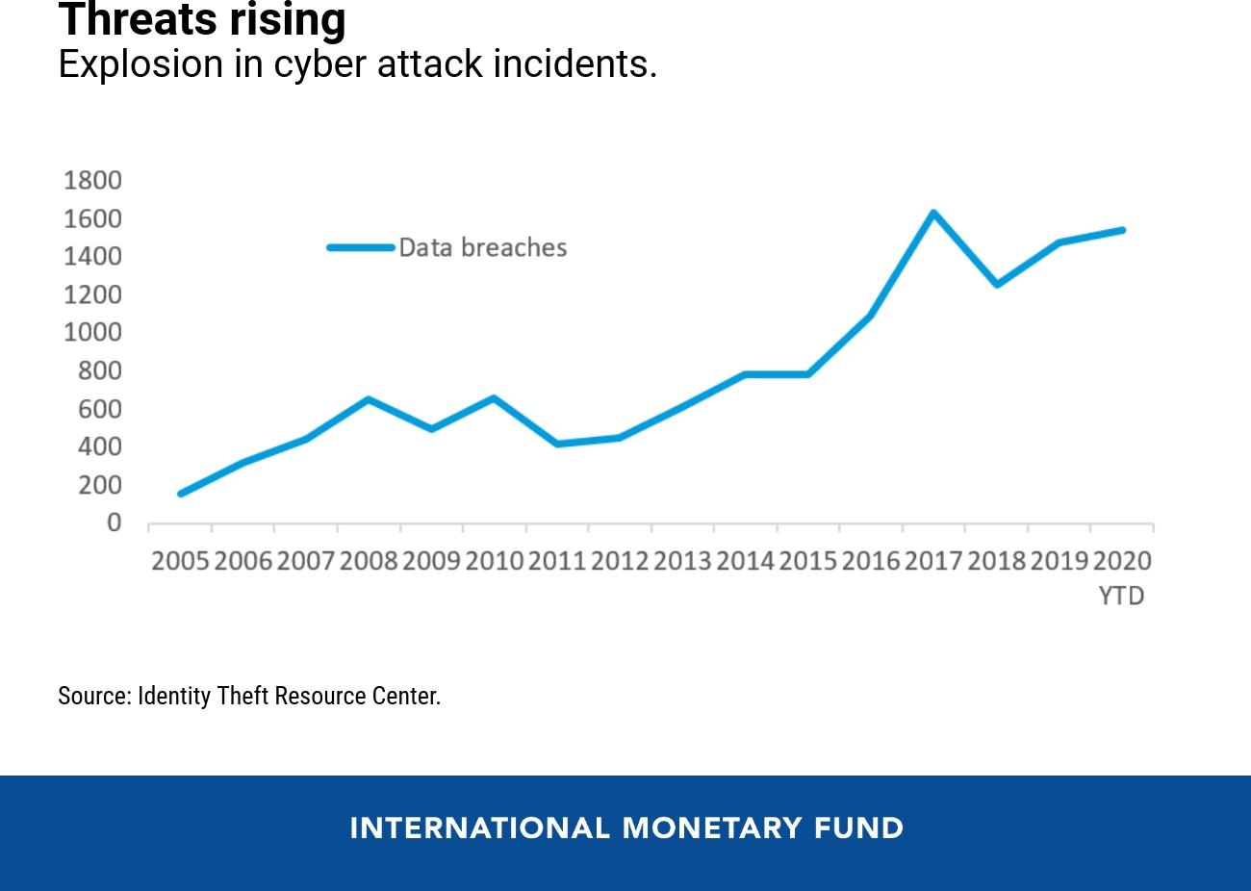
Cyber Risk 101

Slide 14
Its easy, cheap and more Powerful
Hacking tools are now cheaper, simpler and more powerful, allowing lower-skilled hackers to do more damage at a fraction of the previous cost. The expansion of mobile-based services (the only technological platform available for many people), increases the opportunities for hackers. Attackers target large and small institutions, rich and poor countries, and operate without borders. Fighting cybercrime and reducing risk must therefore be a shared undertaking across and inside countries.
According to Gartner (2022), “the average cost of IT downtime is $5,600 per minute. Because there are so many differences in how businesses operate, downtime, at the low end, can be as much as $140,000 per hour.”
IBM’s 2020 Cost of a Data Breach Report found, “Lost business costs accounted for nearly 40% of the average total cost of a data breach, increasing from $1.42 million in the 2019 study to $1.52 million in the 2020

Slide 15
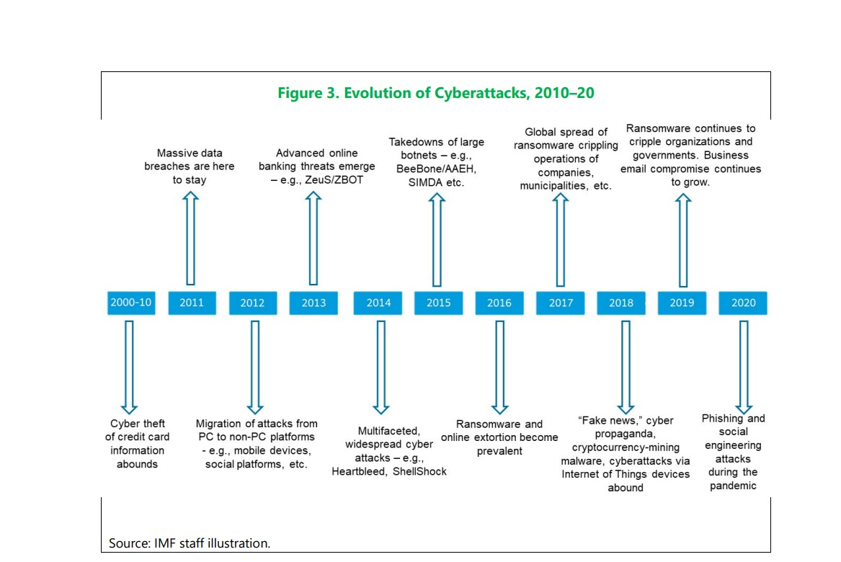

Slide 16
Banking and cybersecurity: What are the biggest threats?
One of the key components of building an effective cybersecurity plan is analyzing and identifying the top threat vectors.
NOTE: The average cost of cybercrime
for financial services is 40% higher than all other sectors

Slide 17
‘Cyber Hygiene’
While the daily foundational risk management work — maintaining networks, updating software and enforcing strong ‘cyber hygiene’ — remains with financial institutions, there is also a need to address common challenges and recognize the spillovers and interconnections across the financial system (the Complexity dynamics more so of interest-bearing debt system).
Individual firm incentives to invest in protection are not enough; regulation and public policy intervention is needed to guard against underinvestment and protect the broader financial system from the consequences of an attack.

Slide 18
“Its the Climate Change Stupid”
LIGHTING TO STRIKE TWICE WITH AN EVEN BIGGER PERHAPS PERPETUAL THUNDER BOLT
T

Slide 19
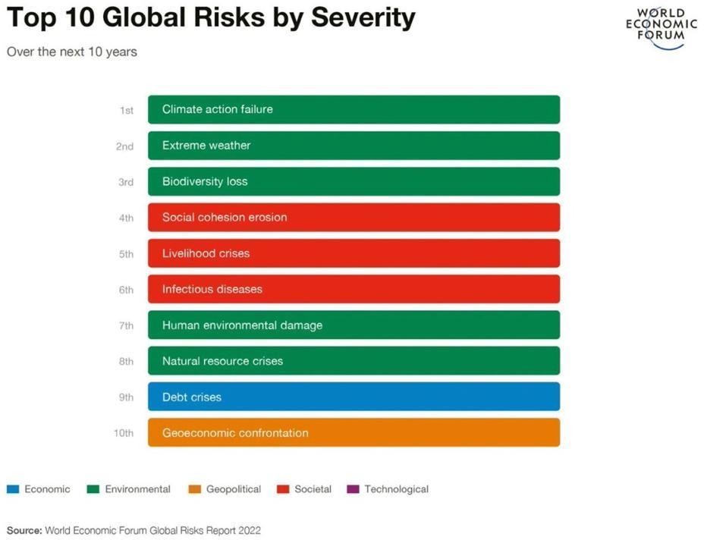

Slide 20
Financial and Insurance sector Hit : ‘Climate Minsky Moment’ as termed by Mark Carney.
The climate change measures does not ideally go well with the working of commodification and financialization driven capitalism, where nature if acquisitive and process accumulative.

Slide 21
Physical Risks
GREEN SWANS
Transition Risks

Slide 22
CLIMATE CHANGE: Some Way Abouts
Quranic, Hadith and Prophet's Tradition preempt, preserve and address on climate change issue some one has to do work on collecting all the versus, hadith and prophet's traditions that signify to preserve environment hence mitigating or avoiding climate change. See, for example, Quran 30:41; 6:141; 7:31; 22:18; 6:38; 57:7-9)
Mitigation and Adaptation Approach: While mitigation tackles the causes of climate change, adaptation tackles the effects of the phenomenon. Adaptation is crucial to reducing vulnerability to climate change. A successful adaptation can reduce vulnerability by building on and strengthening existing coping strategies.
Islamic Climate Change Declaration 2015, prepare way towards Paris accord
United Nations Framework Convention on Climate Change (UNFCCC) for climate management finance A.K.A Climate Finance again Islamic Social finance becomes crucial for developing countries including Iran.

Slide 23
The Conundrum with extra topping of intrinsic Challenges
Emerging vs Developing world the financial and political dilemma,
Globalization intensify (climate) risks,
Climate refugees and new kind of Climate change ridden unemployment other than natural disruptions, food, water and health risks.
Lack of proper reliable Data needed to make understand the full impact of climate change to regulators etc,
New age understanding and securing of Maqasid Al Shariah as it is an auto securing SRI, SDGs, ESGs hence climate change not sure why we don’t promote the same as innate mechanism and why so much of the view to get node first from west than our own.

Slide 24
I. Understanding Dignity of the Financial System
The concept of "financial system's dignity" is not a widely used term, but it can be understood as the recognition of the fundamental human rights and ethical principles that should be upheld by the financial system, in order to ensure that it serves the common good and promotes the well-being of individuals and society as a whole.
RULE OF MAINTAINIGN FINANCIAL SYSTEM’S DIGNITY: “Is it designed to serve the people or are the people end up serving the system”. This can be gauged by observing our approach and workings with regards to all the core and even non core components of the system, be it industry driven, regulatory driven, theory, research and academia driven and/or Shariah driven in case of IF

Slide 25
Organizing Principles of Islamic Finance Hence the Dignity and the Value Preposition
Al-Quran: Verse 275 of Chapter 2
Bay’ (exchange): Necessary Condition.
No Riba: Sufficient Condition.
Present architecture of Islamic Finance
. No Riba, but…..
The Malaysian and Oman Paradigm

Slide 26
Roots of IF’s Dignity Hence the Value Preposition
Epistemology of Islamic Finance.
Islam is a rule-based system
Sources of rules
Kitab as a book of rules
The beloved Messenger (SAWA) as the receiver, interpreter, expounder and administer of rules

Slide 27
To perform 2 basic roles
I) to provide just means to earn income/wealth
II) to manage all the natural risks attached during the process of earning the income/wealth.

Slide 28


What is Bank?

Slide 29
It’s a Financial Intermediary !
Savings & Investment
Financing
Surplus Units
Individuals
Businesses
Government
Deficit Units
Individuals
Businesses
Government
Financial Intermediary
(e.g. bank)
Return on investment
& savings
Return on
financing
Bank’s Liabilities
Bank’s Assets

Slide 30
Why Do
We Need
Islamic Finance?

Slide 31
What is Risk
Simply put: any event carrying more than 1 outcomes is in risk. Risk refers to un-surety that surrounds future events.
Formally put: It is the expression of the likelihood and impact of an event with potential to influence the achievement.

Slide 32
Natural v Unnatural Risk
NATRUAL RISKS
ALLAH CREATED AND UNAVOIDABLE, PART OF NATUAL ORDER, COULD BE MANAGED BUT CAN’T BE ELIMINATED.
UNNATURAL RISKS
MAN MADE, AVOIDABLE, NOT A PART OF NATURAL ORDER, NO NEED TO BE MANAGED AS COULD BE ELIMINATED

Slide 33
FOOD FOR TALK
RISKS
UNCERTAINTY
AMBIGUITY
BLACK SWANS
REGIME UNCERTAINTY
COMPLEXITY
RISK SHARING; ANTI FRAGILITY; ROR
PPP SECUTIRES

Slide 34
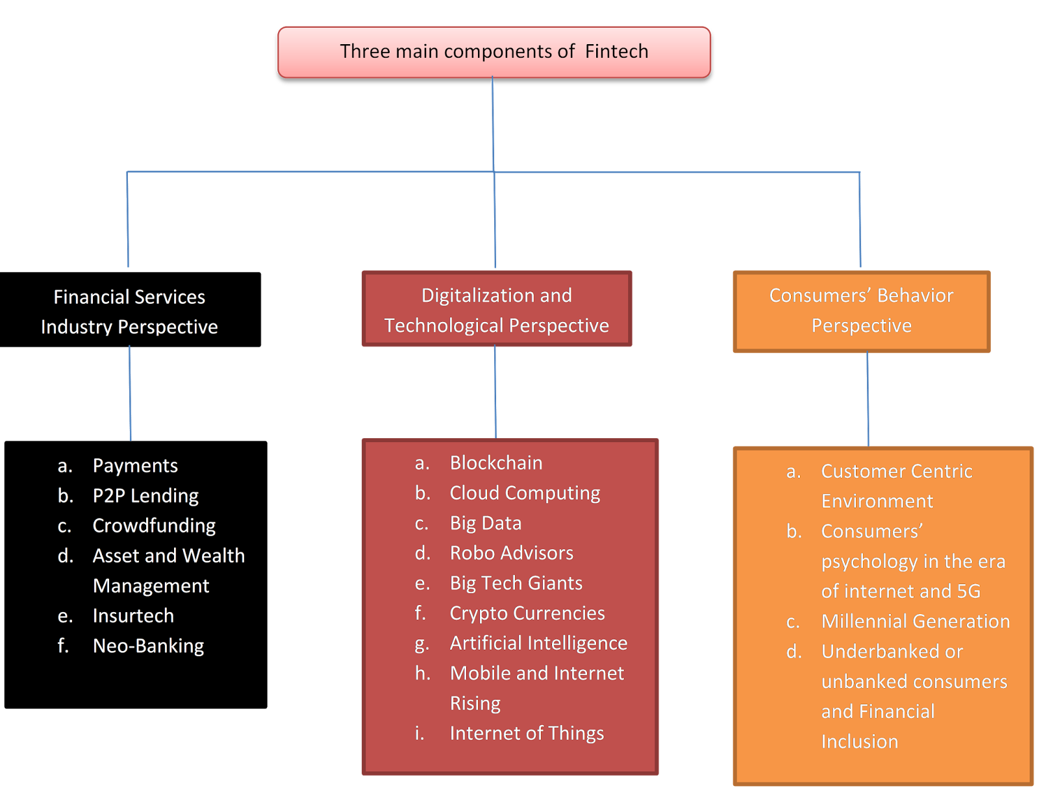

Slide 35
Cont…
Question arises why does Natural risks exists?
How does Islamic finance manages risks?
Through compliance with the given (economic) Rules.

Slide 36
The Qur’an, provides a more compelling explanation:
Humans are subjected to tests throughout their lives to allow them a sense of the degree to which they, individually and collectively, are rule compliant (see for example, Al-Quran: chapter 2 verse 155; chapter 7 verse 130; chapter 76 verse 2; chapter 29 verse 2; chapter 9 verse 126; chapter 11 verse 7). Without risk and uncertainty, testing would not be possible.

Slide 37
New Institutional Economics-NIE
NIE defines institutions as rules and norms governing economic behavior in the society. Accordingly how well the economy performs depends crucially on the rules governing economic behavior. Principles among these are: rule of law, well defined property rights, and a high degree of trust, efficient contract enforcement, and good governance.

Slide 38
Economic Islamicity
Greater justice in ALL aspects of econ mgt
Higher moral standard
Honesty & trust in marketplace, transactions
Poverty eradication
More even distribution of Y & W
No hoarding of W
Less opulence in C
No exploitive speculation
Risk sharing (not debt contracts)
Better social infrastructure & provision of social services
Better treatment of workers
Higher edu exp relative to GDP
Higher S & I rates
Higher environmental preservation
Vigilantly supervised markets
Rule compliance
Eco devp & growth
Islamic economic system
Notes:
DIAGRAM: Fundamental elements → MARKET BASED SYSTEM BUT ENTRENCHED WITH ISLAMIC BEHAVIOUR AND GOALS (OBJECTIVES / RULES/ INSTITUTIONS)
BULLETS reflect comparison to the Conventional Econ System.

Slide 39
EI² Ranking
Malaysia 33 | Guyana 109 | Nigeria 160
Kuwait 42 | Qatar 111 | Mali 164
Kazakhstan 54 | Morocco 120 | Burkina Faso 167
Brunei 55 | Egypt 128 | Syrian ArabRep168
Bahrain 61 | Algeria 131 | Guinea 171
UAE 64 | Uzbekistan 132 | Libya 174
Turkey 71 | AVERAGE 133 | Benin 176
Tunisia 72 | Iran 139 | Yemen Rep 180
Jordan 74 | Bangladesh 141 | Cameroon 181
Azerbaijan 80 | Mozambique 142 | Mauritania 182
Oman 82 | Gabon 143 | Chad 187
Lebanon 87 | Pakistan 145 | Niger 188
Saudi Arabia 91 | Tajikistan 147 | Sudan 190
Turkmenistan 92 | Iraq 148 | Togo 195
Maldives 95 | Afghanistan 149 | Comoros 197
Kyrgyz Rep 96 | Gambia 151 | Somalia 199
Uganda 99 | Senegal 152 | Sierra Leone 200
Indonesia 104 | Djibouti 155 | Vote d’Ivoire 201
Albania 105 | Suriname 156 | Guinea-Bissau 202
OIC countries’
Notes:
Additional info:
The Islamic countries with Muslim homogeneity or whose population consist of over 90% Muslims fared very poorly: Saudi Arabia at 91st place, Indonesia at 104th, Morocco at 120th, Egypt at 128th, Iran at 139th and Pakistan at 145th.

Slide 40
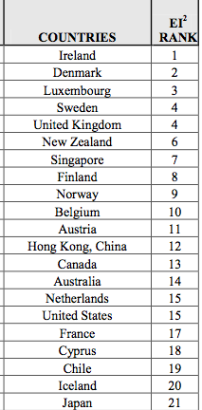
EI² Ranking
Top 20
- none of OIC countries
Notes:
On the other hand, the top five countries with more “Islamic” systems, in ranking order, were Ireland, Denmark, Luxembourg, Sweden, and United Kingdom. Australia ranked 14th whilst USA ranked 15th jointly with Netherlands.

Slide 41
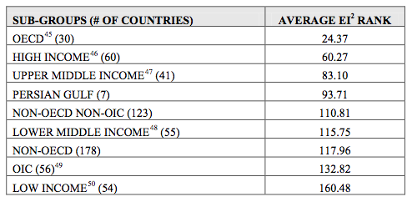
Subgroups: Average EI² Rank
US$10,066 ++
US$826 – US$10,065
US$826 – US$10,065
Below US$825
Notes:
1. OIC vs OECD → NOT SURPRISING : OECD countries do adhere to free markets and good economic governance → in line with islamic
OECD countries: 31 most highly industrialized and rich market democracies that produce around 60% of the world’s goods and services
2. OiC averages still below Lower Middle Income

Slide 42
Rule Non-compliance
Major Rule non-compliance is violation i.e. the absence of ‘Albay’ (risk sharing) and continuation of riba (interest) with the (ch 2 verse 275).

Slide 43
Reasons for rejuvenation of Islamic finance
Severe Market Failure in terms of Lack of mitigation of economic risks; intensified due to risk transfer and risk shifting. The hallmarks of an interest based debt system.
Unmet Demand for Shariah Compliant products

Slide 44
Islamic economic rules
However, Quranic rules extend well beyond what the NIE would consider needed for a well-functioning economy.
see for example chapter 5 verse 2; chapter 3 verse 103; chapter 8 verse 46). The promise made in the verse 96 of chapter 7 of the Quran (see also chapter 65 verse 2; chapter 65 verse 3; chapter 5 verse 65-66; chapter 12 verse 90’ chapter 5 verse 66; chapter 8 verse 53; chapter 10 verse 9; chapter 2 verse 25; chapter 16 verse 97; chapter 24 verse 55; chapter 40 verse 40.

Slide 45
ORGANIZING PRINCIPLES OF ISLAMIC FINANCE
Al-Quran: Verse 275 of Chapter 2
“Allah has permitted Al-bay but has forbidden Riba”

Slide 46
Cont…
Al-Bay’ (exchange): Necessary Condition.
No Riba: Sufficient Condition i.e. a crucial ethic of doing Al-Bay smoothly & properly
However
Present architecture of Islamic Finance focuses only on
No Riba, but…..
Mainly because there appear to be a
Presence of Cognitive deficiency and Dissonance leading to deficiency of effectively understanding the massage and framing risk sharing: the essence of Islamic finance.

Slide 47
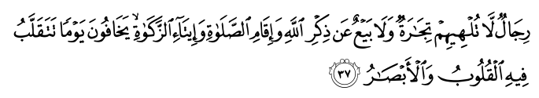
Al-bay is not Al-tijarah
A number of interpretations suggest that trade and exchange are the same. The terms of Al-Bay’ (exchange) and Al-Tijarah (trade) appear in a number of verses. In at least one verse (verse 37: chapter 24, Surah Al Nur)
Consulting major lexicons of Arabic language – for example, Al-Tahqheeqh Fi Kalamat Al-Quran Al-Kareem; Lisan Al-‘Arab; Mufradat Alfadh Al-Quran – reveals that Al-Bay’ (exchange) and Al-Tijarah are not the same.
Based on the Quran itself (verse 16: chapter 2; 254:2, 111:9; 29-30:35; and 10-13:61), these sources suggest there is a major difference between contracts of exchange (Al-Bay’) and trade (Al-Tijarah).
Trade contracts are always entered into with the expectation of making a profit (ribh). In a contract of exchange on the other hand, there is a possibility of gain but there is also the probability of a loss (khisara).

Slide 48
Cont…
Central among the rules that constitute the institutional frame work of an Islamic economic system are rules governing:
Property Rights
Contracts
Market conduct
Production and Exchange
Distribution and redistribution

Slide 49
Property rights
The Quran makes it clear that all property (including natural resources as well as human physical and mental capabilities) belongs to Allah swt whose ownership never diminishes and remains always constant—thobat melkiyyah of Allah swt.
All the humanity has rights in His property.
no one can be denied the rights to property. These rights must be redeemed, in kind or in monetary equivalence (see for example chapter 51 verse 19; chapter 24 verse 33; chapter 16 verse 71).

Slide 50
Cont…
Once the basic rules of property rights have been laid, the next step is how these rights are gained. In Islam, there are only two ways in which individuals can gain legitimate property rights.
(i) Individuals can gain property rights through a combination of their own creative labour and other resources or
(ii) through transfer—via exchange, contracts, grants or inheritance—from others who have gained property rights title to an asset through their own labour (see chapter 53 verse 40; chapter 17 verse 26; chapter 24 verse 22; chapter 30 verse 38; chapter 4 verses 11-12).

Slide 51
Cont…
The others rules relate to the impositions and limitations on disposing a property over which legitimate rights are claimed. Property owners have a severely mandated obligation not to
waste (Israf),
squander or destroy (Itraf),
or use property opulently (Itlaf) or as means of attaining unlawful purposes.

Slide 52
Faithfulness to Contracts
In verse 152 of chapter 6 the Quran urges the believers to fulfil the covenant of Allah.
They are ordered to protect faithfulness to their covenants and what has been placed in trust with them as a shepherd protects sheep (see chapter 23 verse 8; also chapter 17 verse 34; chapter 2 verse 2; chapter 16 verse 91-92; chapter 3 verse 61).
So much so that the Quran has dedicated the longest verse on the importance of contracts and their fulfilment (see chapter 2 verse 282).

Slide 53
Markets
In an Islamic economic system, market is only an instrument of the system and not the whole system itself; well supervised and well regulated. Supervised and regulated in terms of the rules that govern market behavior. The rules come from the life of the Prophet (saw). The rules include:
No interference with supply;
No interference with demand; and no interference in exchange transaction;
Full access to the market by all buyers and sellers;
Shariah approved sources of factors and products before they enter the market;
Provision of full information regarding qualities, quantities and prices of factors of production and product to all buyers and sellers—before the start of price bargaining process;

Slide 54
Cont…
Provisions of full weights and measures; there is no hoarding of commodities, if two people in market are negotiating, third person cannot interject himself;
“There is no ‘Ghash’ meaning there should not be any kind of misrepresentation of the product.
No Gharar and a strict prohibition of speculative activities;
“The freedom of annulment” i.e. ‘Khiyarat’. There are various kinds of such freedoms provided to both parties (depending on the fiqh) to annul contracts.
“Full and transparent Information”. Everything about the product must be known and nothing should be hidden. Anyone who enters the market is informed fully of prices and products.
“No collusion among the sellers or buyers” or else they will violate the rule of ‘No Ghash’.
It is important to note that for the economy to function well as per the rules of Islam, the whole nexus of these rules have to apply together. Any single violation of anyone of the above rules can and will creates severe frictions in the sound functioning of the economy as a whole.

Slide 55
Rules regarding Consumption
A further set of rules decouple the relationship usually assumed in the secular thought between consumption and income that as income grows so does consumption. For those who have internalized the Islamic economic rules, this is only true to a limited extent because there are limits to their consumption. That is, at low levels of income, consumption grows with income but after a threshold is reached, consumption levels off as additional income earned are channeled back to the economy through investment or transfers to more needy (see chapter 7 verse 31; chapter 25 verse 67; chapter 23 verse 64; chapter 17 verse 16; chapter 34 verse 34; chapter 17 verse 26-27).

Slide 56
Distribution and Re-distribution
Due to the fact that some members of the society may be physically or otherwise unable to access resources to which they are entitled— as per the property rights rules of Islam (see chapter 6 verse 165; chapter 43 verse 23; chapter 16 verse 71), inequalities between income and wealth arise.

Slide 57
Cont…
To avoid this Islam—as mentioned above—prohibits excessive wealth accumulation and imposes limits on consumption after maintaining modest living standards. The surplus must be returned to the members of the society who, for a variety of reason, are unable to work. Further Mechanisms for redeeming the rights of the less able in the income and wealth of the more able are the network of mandatory and voluntary payments such as Zakat (2.5% on wealth), Khums (20% of income), and payment referred to as ‘Sadaqat’ (see chapter 9 verse 60; chapter 22 verse 41; chapter 2 verse 110, 261; chapter 34 verse 39; chapter 57 verse 18; chapter 73 verse 20).

Slide 58
Circulation of Wealth
As mentioned earlier, to allow a healthy circulation of wealth, the Islamic economic system envisions a financial system based on risk and return-sharing alongside the prohibition of interest bearing transactions in which rent is collected as a percentage of an amount of principal loaned for a specific time period.
The overwhelming emphasis the Quran places on the contracts of exchange as the alternative to the interest rate-based debt contract is a clear instruction that the financial system must be structured on risk sharing rather than risk shifting or risk transfer.

Slide 59
MEETHAQ
The Primordial Covenant
Al-Baqara: verse 27; 63; 83; 93;84
Al Maidah: verse 7; 70;14;12; 13
Al Rad : verse 25; 20
Al-Nisaa: verse: 21; 90; 154-155
Al-Imran: verse: 81;187
Al-Ahzab : verse 7
Al Hadid : verse : 8

Slide 60
HALAL TAYYAB
Al- Baqara: Chapter 2: Verse 168 ; An-Nahl, Chapter 16: Verse 114; Al-Isra: Chapter 17: Verse 70;
Al-Maeda, Chapter 5, Verse 4; Al-Maeda, Chapter 5, Verse 88
Al-Araf, Chapter 7, Verse 32; Al-Mumenoon, Chapter 23, Verse 51,
Taha, Chapter 20, Verse 81; Al-Anaam, Chapter 6, Verse 145

Slide 61
ORGANIZING PRINCIPLES OF ISLAMIC FINANCE
Al-Quran: Verse 275 of Chapter 2
“Allah has permitted Al-bay but has forbidden Riba”

Slide 62
The Cause-Effect/Challenges Conundrum

Slide 63
List of Challenges that needs confrontation
Path Dependency: Over reliance on debt based/creating products where global balance sheet of I.Bs features 94% fixed rate instruments.
Presence Interest rate based Macroeconomic Policies.
Problem of the lender of last resort
• Corporate and Shariah governance of IFIs
Lack of instruments of hedging or liquidity
-Increased Cost of Information
-Control over Cost of Funds
-Interest rate as bench mark
No capital market, money market and an Islamic stock market.
Lack of Dynamic and strong regulatory and supervisory capacity
The biased tax and Legal system
Risk Management in Islamic finance
Shariah Harmonization/standardization
Lack of Government participation
No government support for risk sharing
Need for Human capital particularly those who are aware of the core theoretical underpinnings of Islamic finance.

Slide 64
THE NEW NORMAL
The Post Covid World
The Tech/Digital Disrupted World
The Cyber and Cyber Security Prone World
The Climate Change Ridden World
The Renewable Energy World
The Shifting to another Planet World

Slide 65
Constraints on progress of Islamic Finance toward the Ideal Model.
Need a New Fiqh.
Macroeconomic Policies.
Framing and Need for a Change in Perception: A dignity Conscious Perception.
Branding and Lobbying

Slide 66
Standardisation secures integrity of Islamic finance
2.
industry not compromising on the minimum level of Shari’ah-compliance in all areas of operations;
3.
industry adopting the best practices;
4.
industry enjoying the trust and confidence of its stakeholders; and
5.
industry is stable, sustainable, and competitive.
Standardisation is important to secure the integrity of Islamic finance where integrity is characterized by the following:
1.
industry moving in one direction towards realization of Maqasid Al Shari’ah;

Slide 67
Standardisation benefits all Islamic finance stakeholders
Standardization and harmonization of best practices in Islamic finance
leads to
Islamic finance stakeholders
Higher levels of trust because of higher:
Benefits to economy
Benefits to regulator
Benefits to investor
Benefits to IFIs
attracts foreign investment
No need to reinvent the wheel and develop the standards from scratch
better forecasting
better governance
interoperability of products
comparability
better resource allocation
better decision-making
lower cost of capital
better HR availability
transparency
Secure adequate capacity in the market
reduced costs
uniformity of processes
increased wealth
reliability
improved intl. reputation
Increased focus on supervision
higher productivity
appropriate risk management
understandability
attracts foreign talent
Internal capacity shortage does not become a challenge
higher legal security
accountability
attracts foreign technology
higher adaptability
timeliness

Slide 68
mshaukat@aaoifi.com
cbp@aaoifi.com

